Slide 1
MAGIC tutorial

Slide 2
MAGIC (Markov Affinity-Based Graph Imputation of Cells)
MAGIC is an interactive tool to impute missing values in single-cell data and restore the structure of the data.
It also provides data preprocessing functionality such as dimensionality reduction and gene expression visualization
If you use MAGIC, please cite:
MAGIC: A diffusion-based imputation method reveals gene-gene interactions in single-cell RNA-sequencing data
Biorxiv (preprint) February 2017. DOI: doi.org/10.1101/111591

Slide 3
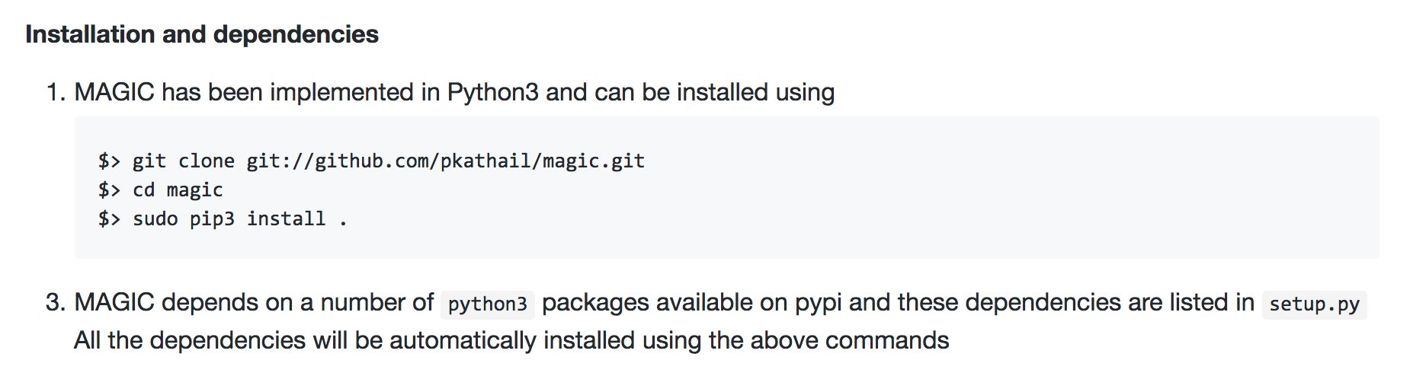
Install MAGIC
Go to https://github.com/pkathail/magic
Use the following instructions to install MAGIC

Slide 4
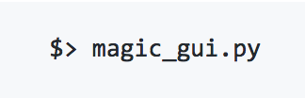
Launch MAGIC
After following the steps to install MAGIC, the gui can be launched with the following command:

Slide 5
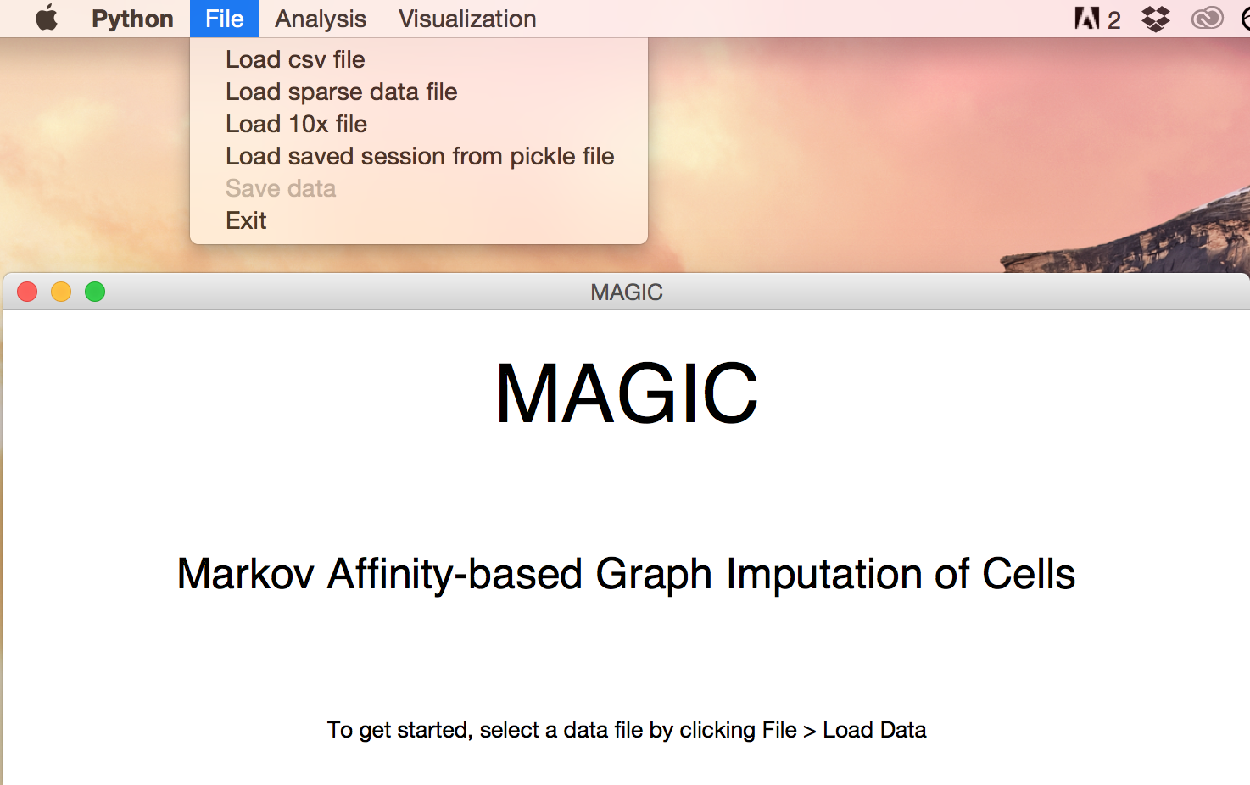
Loading data
After launching MAGIC, data can be loaded as either a csv file, sparse data in the mtx format or 10x format, or as a pickle file from a previous MAGIC session.

Slide 6
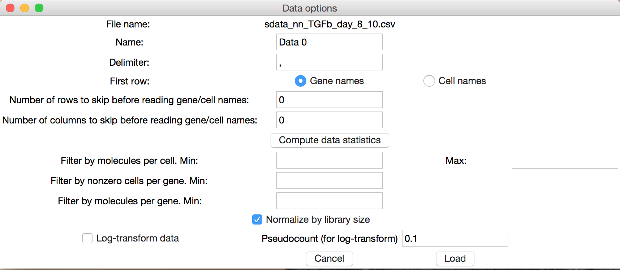
Loading data
After selecting a file, you will be prompted to enter a name for the data and give options with which to filter and normalize the data before loading

Slide 7
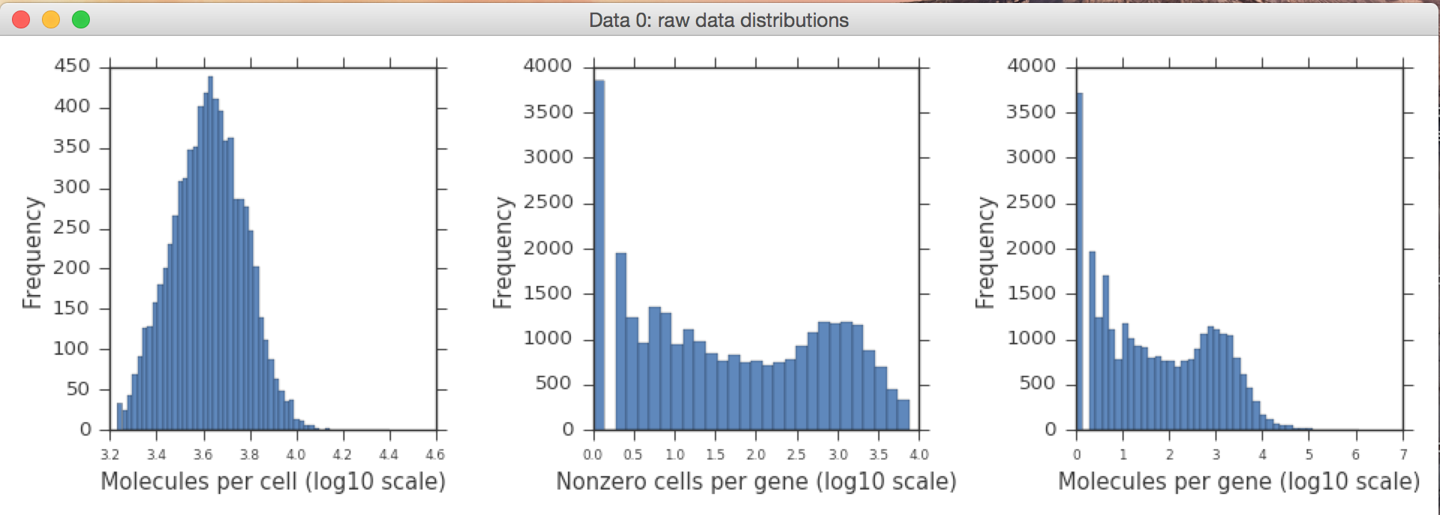
Loading data
By selecting ‘Compute data statistics’ you can generate plots to assist in selecting the filtering cutoffs

Slide 8
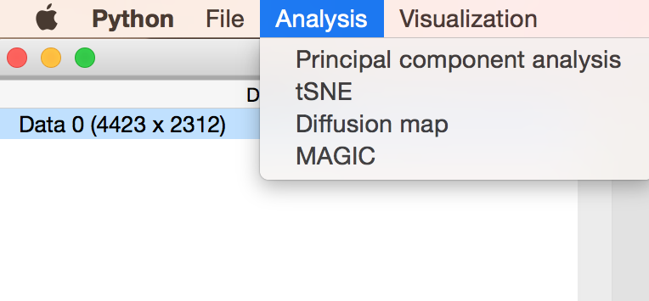
Analysis
After loading a dataset, it can be analyzed using a number of different methods: PCA, tSNE, diffusion maps, and MAGIC.
To run one of these methods, select the dataset or datasets you would like to use in the column on the left and then select the method from the Analysis menu.
You will be prompted to specify certain parameters depending on the method

Slide 9
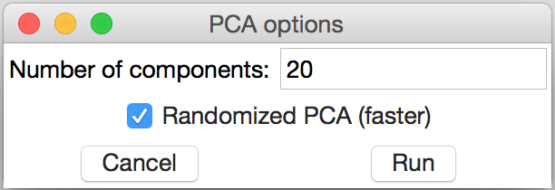
PCA (Principal Component Analysis)
When running PCA, you will be prompted to enter the number PCA components to compute and whether or not you would like to use a randomized svd solver in the PCA computation (randomization speeds up the computation and is recommended for larger datasets)

Slide 10
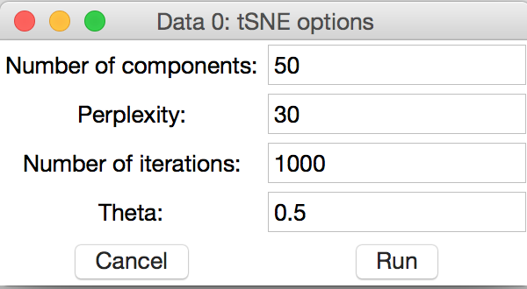
t-SNE
When running t-SNE, you will be prompted to select values for several t-SNE parameters.
Details about selecting values for these parameters are included in the sklearn.manifold.TSNE documentation (http://scikit-learn.org/stable/modules/generated/sklearn.manifold.TSNE.html)

Slide 11
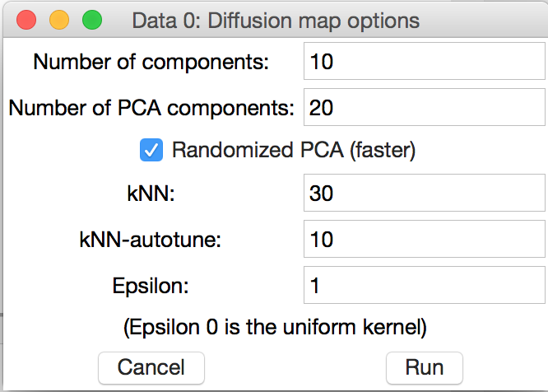
Diffusion map
When running diffusion maps, you will be prompted to enter the number of diffusion components to compute and the number of PCA components to use in the computation.
You will also be asked for values for kNN, kNN-autotune, and epsilon (the standard deviation of the kernel).

Slide 12
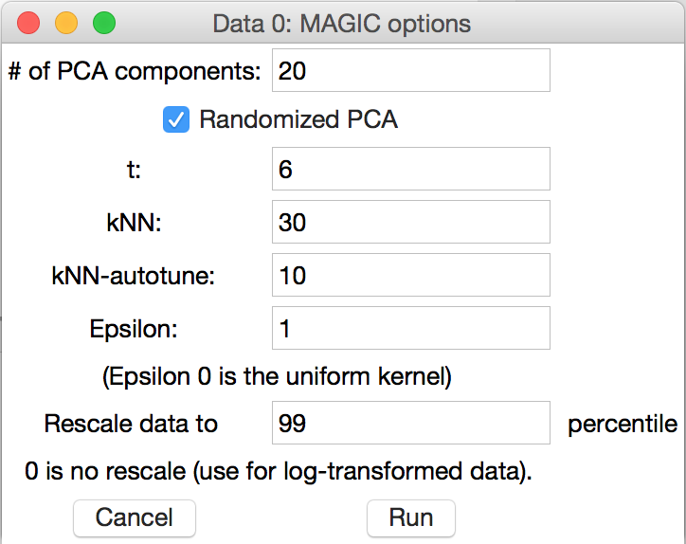
MAGIC
Similar to diffusion maps, when running MAGIC you will be prompted to enter the number of PCA components to use in the computation as well as values for kNN, kNN-autotune, and epsilon.
It is suggested to set the ‘t’ parameter to 6 to begin with and then try increasing it up to ~12.
The data can also be rescaled,
although this should not be
performed on log-transformed data.

Slide 13
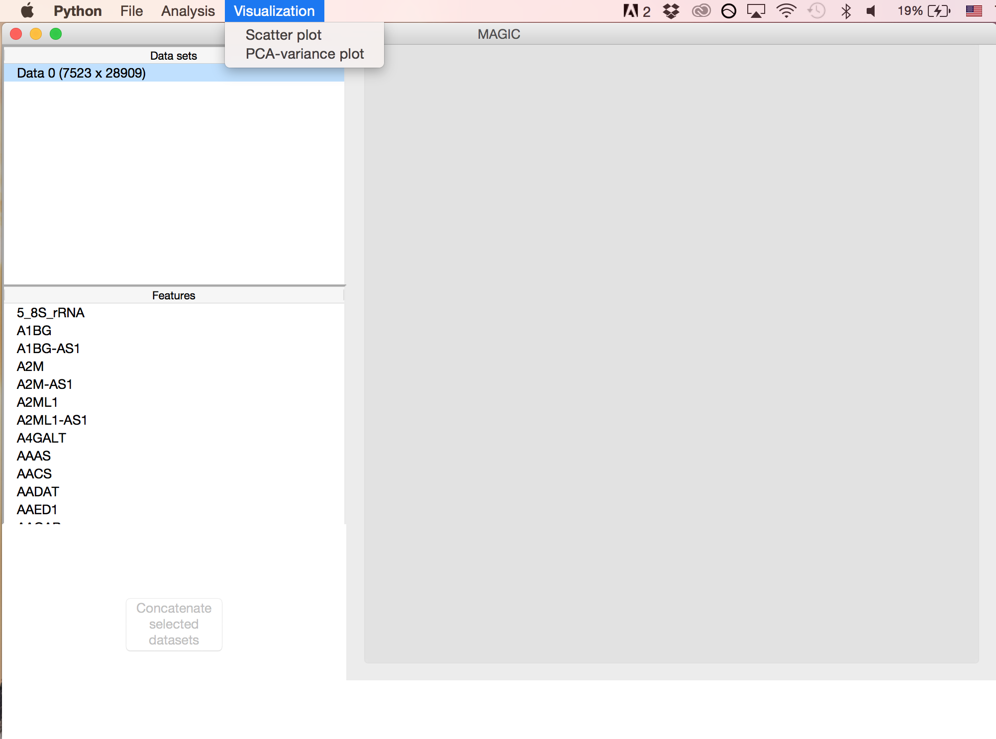
Visualizations
The data can be visualized through a PCA-variance plot or numerous customizable 2D and 3D scatter plots.

Slide 14
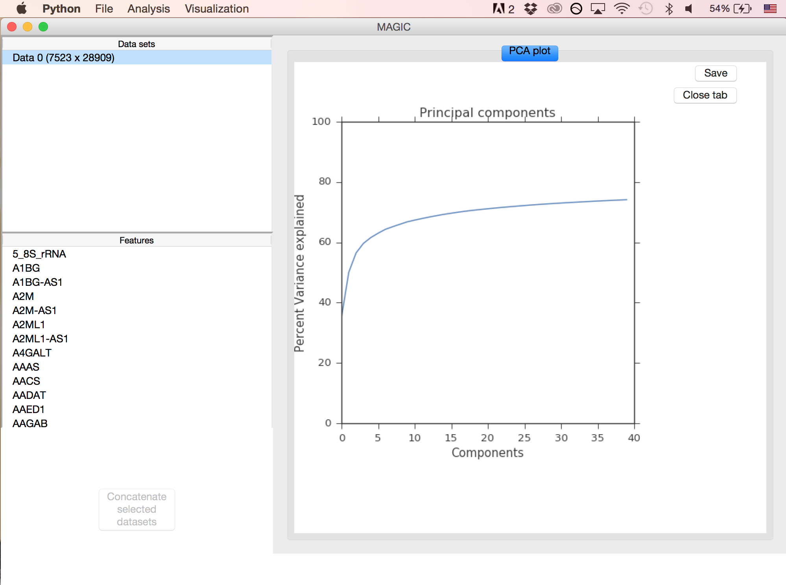
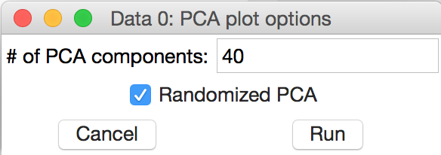
PCA-variance plot
To visualize the cumulative percent of variance explained by the PCA components, select PCA-variance plot from the Visualization menu.
You will be prompted to select the number of components you would like to visualize.

Slide 15
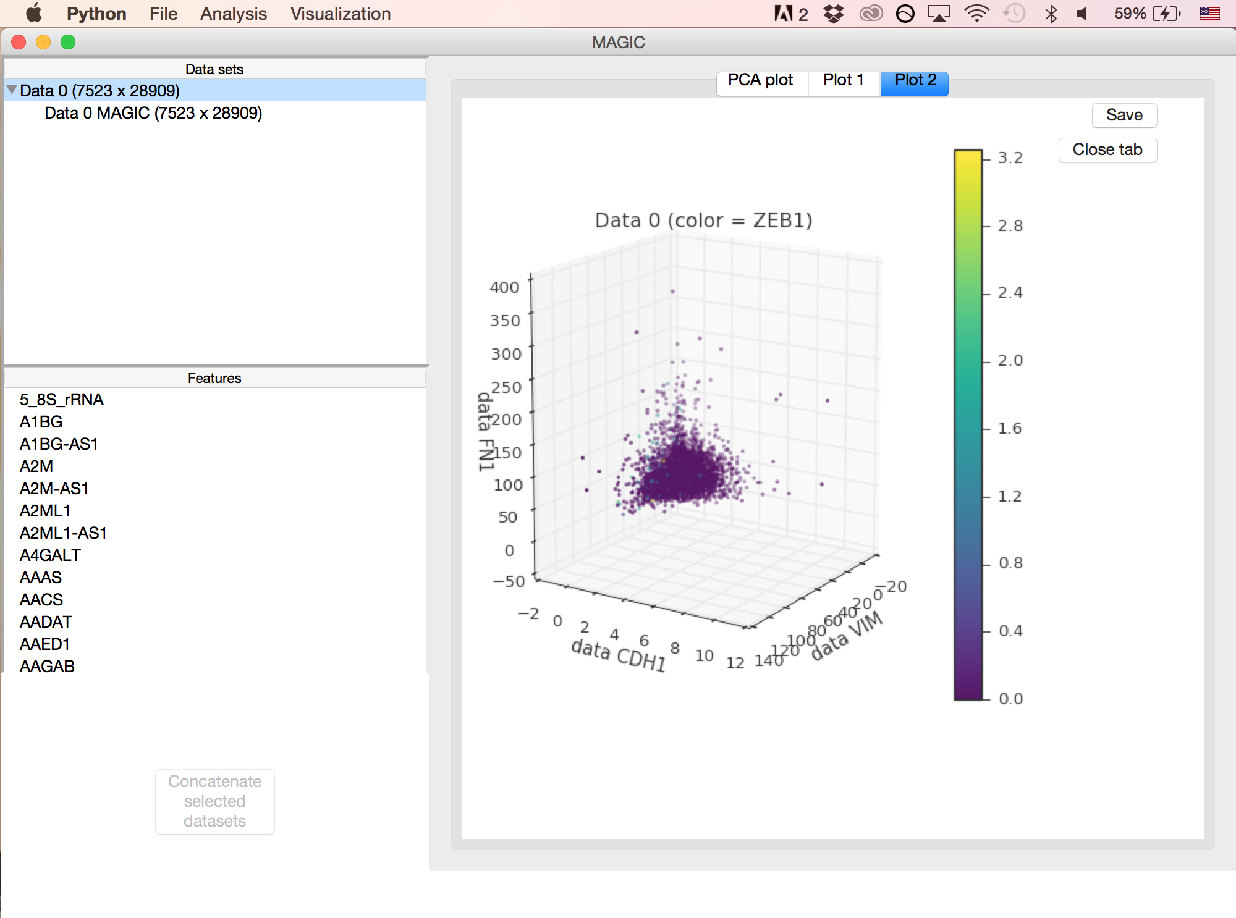
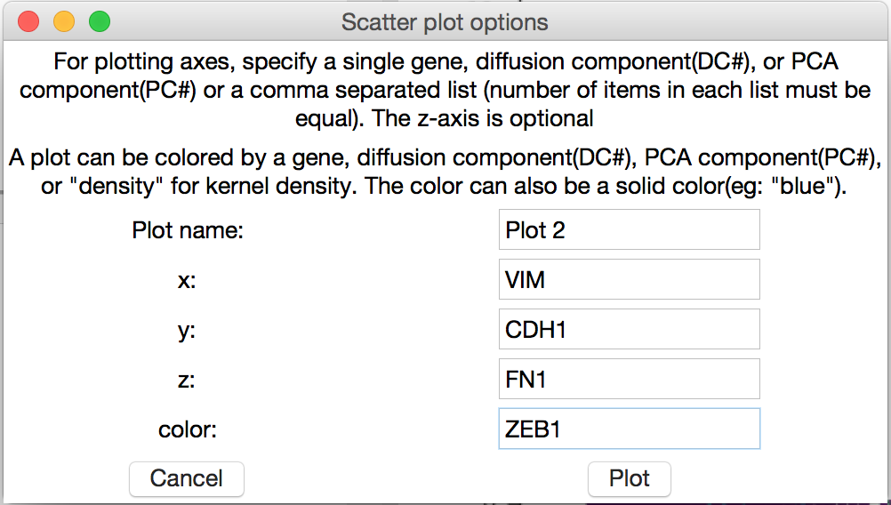
Gene expression scatter plots
Highlight the dataset(s) you would like to scatter and then select ‘Scatter plot’ from the Visualization menu.
A 2D plot can be created by simply leaving the z-axis field blank.

Slide 16
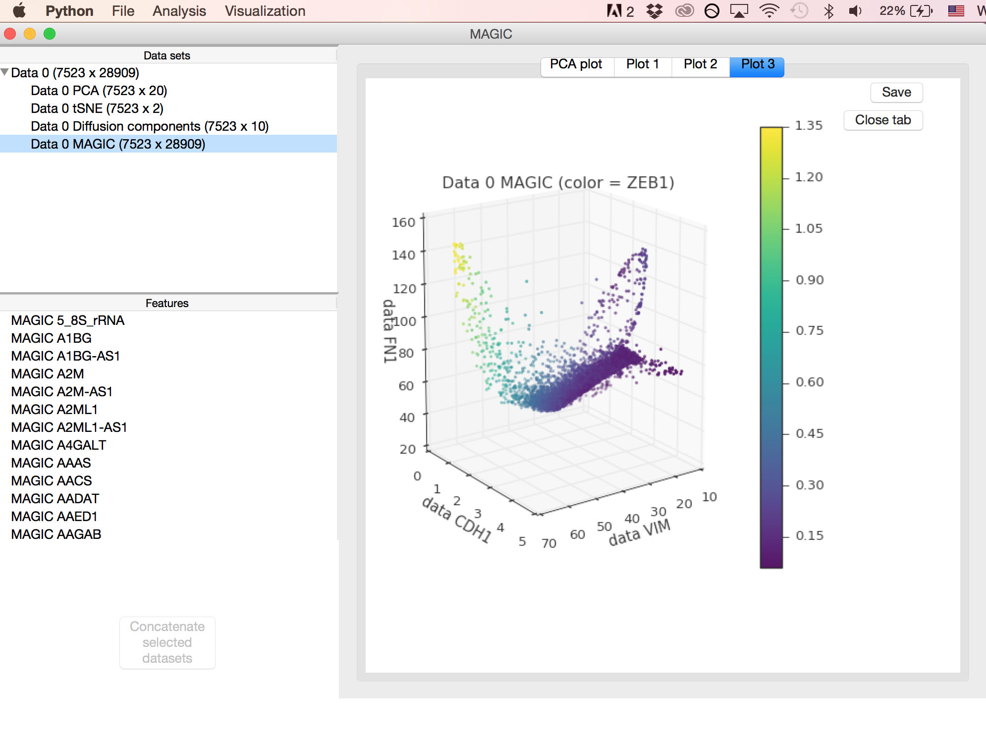
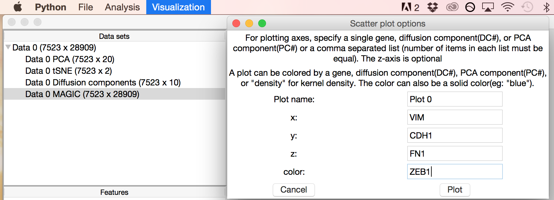
Gene expression scatter plots (MAGIC)
The same plot can be created using the MAGIC-ed version of the data by instead highlighting the MAGIC dataset before plotting

Slide 17
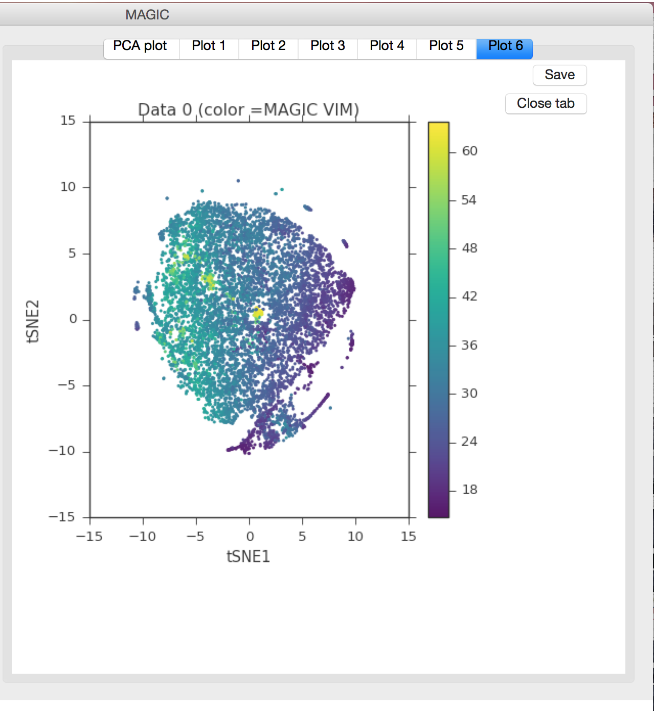
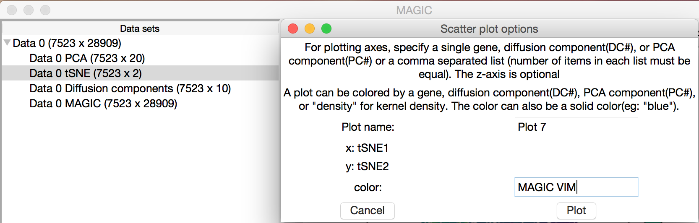
t-SNE Scatter Plots
Highlight the tSNE subset of the dataset(s) you wish to plot and select the ‘Scatter plot’ option from the Visualization menu.
You will be prompted to give a gene, principal/diffusion component, ‘density’, or solid color to color the plot with.
If a comma separated list of color options is given, multiple plots will be made with each of the color selections

Slide 18
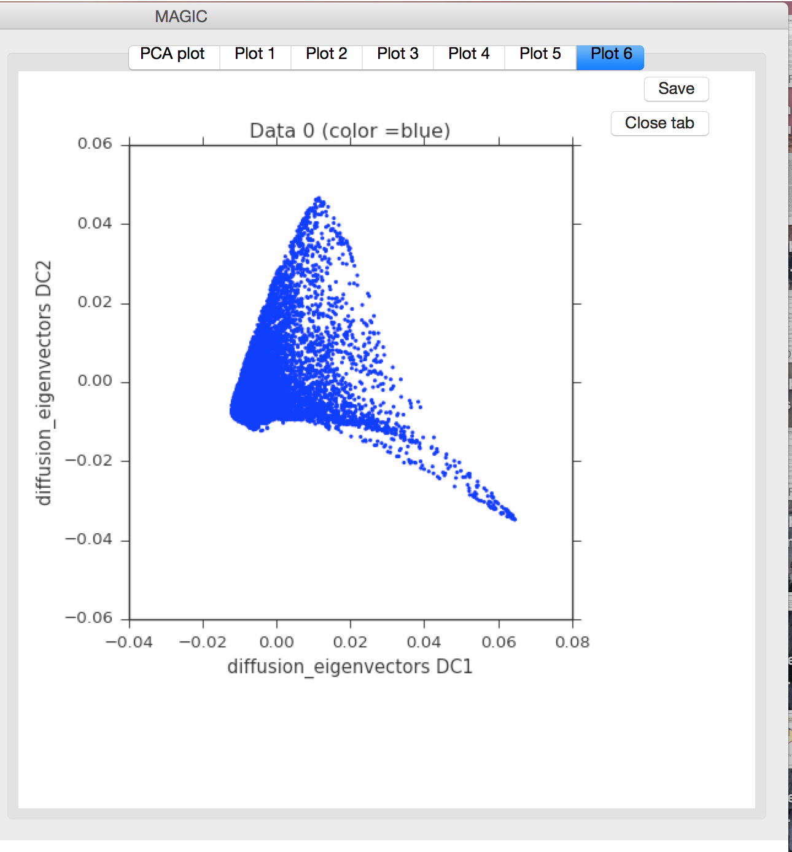
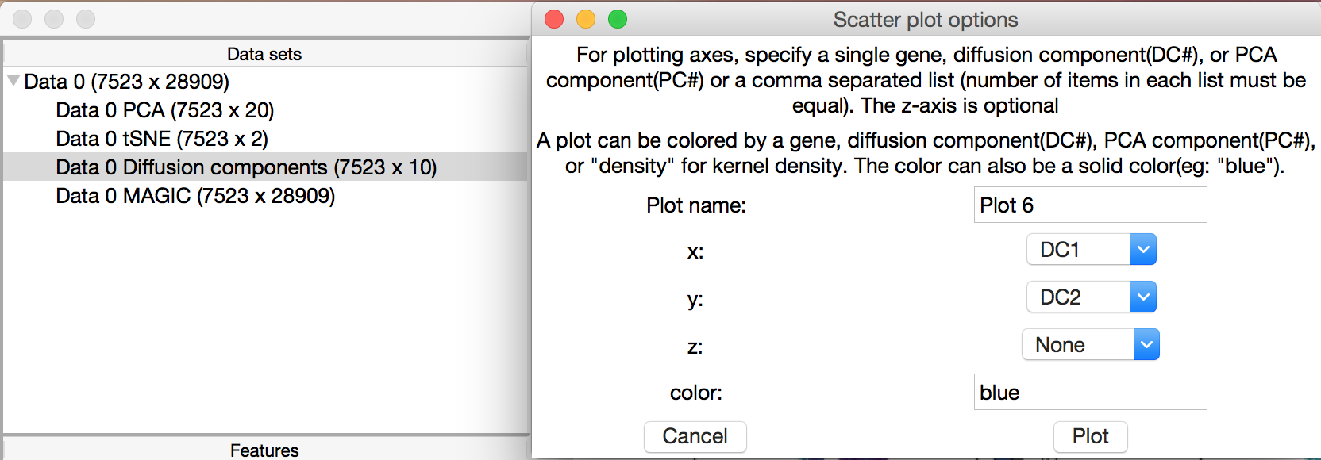
PCA & Diffusion Component Scatter Plots
Highlight the PCA or Diffusion Component subset of the dataset(s) you wish to plot and select the ‘Scatter plot’ option from the Visualization menu.
You will be prompted to select a component to use for each of the plotting axes. A 2D plot can be made by leaving the z-axis blank.
You will also be asked to give a gene, principal/diffusion component, ‘density’, or solid color to color the plot with.

Slide 19
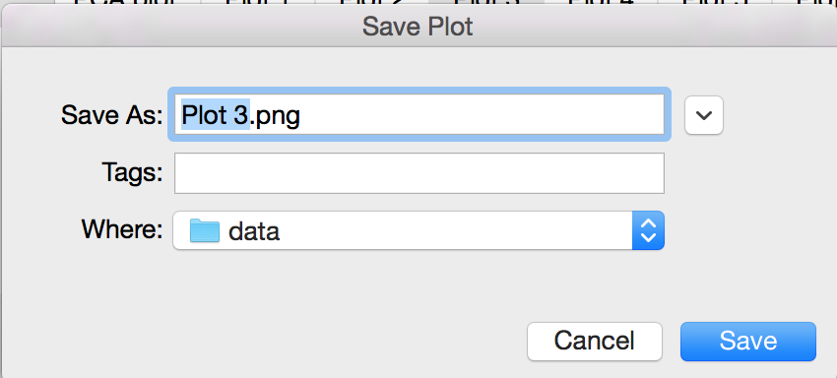
Saving plots
Each visualization can be saved using the ‘Save’ button in the upper right corner of the frame.

Slide 20
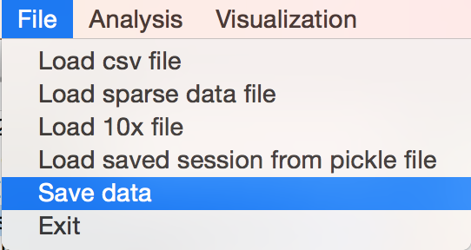
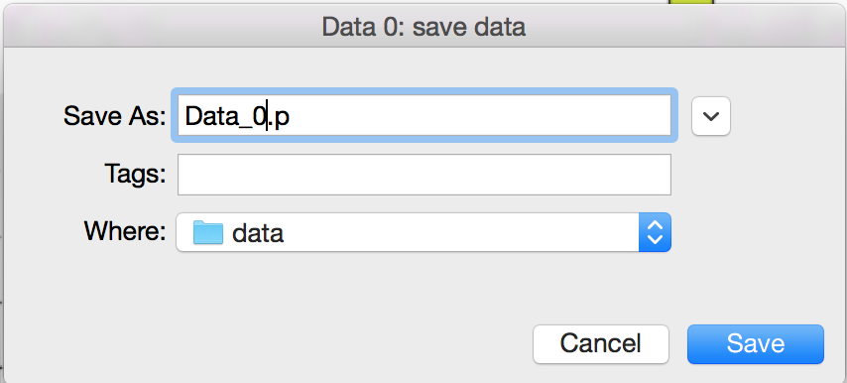
Saving data
All of your data and analysis can be saved and reloaded into MAGIC at a later time.
Select File > Save data to save your current progress as a pickle file; the data can be saved at any stage of analysis
The saved pickle file can be loaded using File > Load saved session from pickle file

